Slide 1
Hamiltonian Cycle using Backtracking

Slide 2






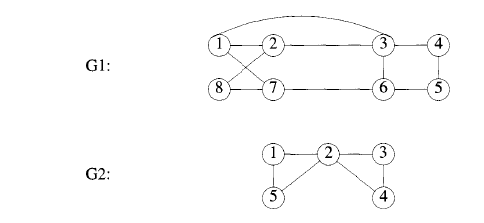
Hamiltonian Cycle Problem
Let G = (V, E) be a connected graph with n vertices. A Hamiltonian cycle
a round-trip path along ‘ n’ edges of G that visits every vertex once and returns to its starting position
In other words if a Hamiltonian cycle begins at some vertex ‘v₁’ ε G and the vertices of G are visited in the order then the edges
are in E, and the are distinct except for and which are equal.
For G1:
Hamiltonian cycle 1,2,8, 7, 6,5, 4, 3,1
For G2:
No Hamiltonian cycle

Slide 3
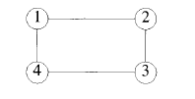
Hamiltonian Cycle Problem
1-2-3-4-1
2-3-4-1-2 all are same cycles

Slide 5

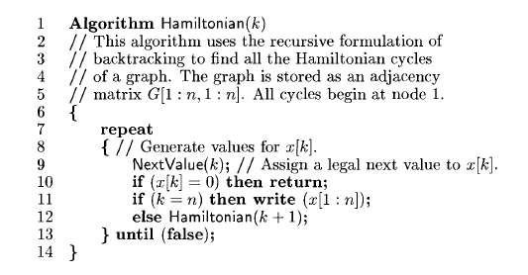
Hamiltonian Cycle Problem

Slide 6
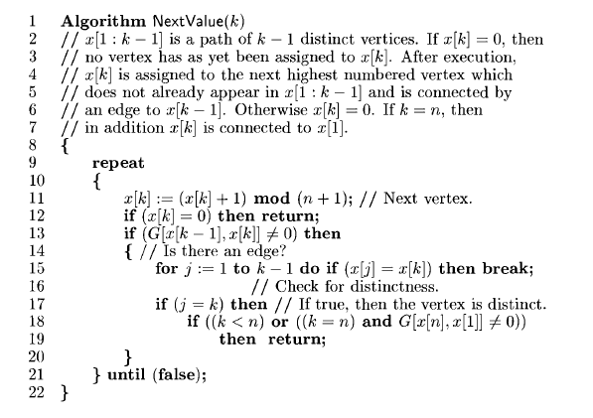
Hamiltonian Cycle Problem

